Slide 1
Memory Hierarchy
CSE-3109 Computer Architecture Lecture 10

Slide 2
Principle of locality
In computer architecture, locality of reference, also known as the principle of locality, is a term for the phenomenon in which the same values, or related storage locations, are frequently accessed, depending on the memory access pattern.
Temporal locality: The principle stating that if a data location is referenced then it will tend to be referenced again soon.
Spatial locality: The locality principle stating that if a data location is referenced, data locations with nearby addresses will tend to be referenced soon.

Slide 3
Memory Hierarchy
A memory hierarchy consists of multiple levels of memory with different speeds and sizes.
The faster memories are more expensive per bit than the slower memories and thus smaller.
Three technologies used in building memory hierarchies:
DRAM (dynamic random access memory) (Main memory)
SRAM (static random access memory) - TechTarget (Cache)
Magnetic disk (Hard disk)

Slide 4

Memory Hierarchy
The goal is to provide the user with as much memory as is available in the cheapest technology, while providing access at the speed offered by the fastest memory.

Slide 5
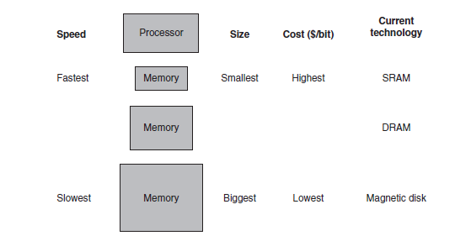
Memory Hierarchy

Slide 6
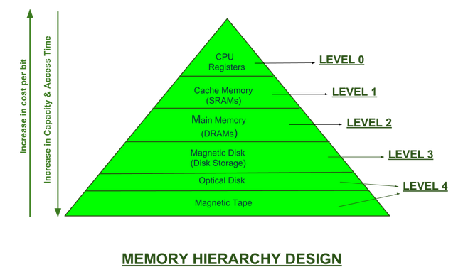
Memory Hierarchy

Slide 7
Data Hierarchy
A memory hierarchy can consist of multiple levels, but data is copied between only two adjacent levels at a time, so we can focus our attention on just two levels. The upper level—the one closer to the processor—is smaller and faster than the lower level, since the upper level uses technology that is more expensive.
Within each level, the unit of information that is present or not is called a block or a line. Usually we transfer an entire block when we copy something between levels.

Slide 8
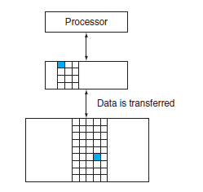
Data Hierarchy

Slide 9
Hit and Miss
If the data requested by the processor appears in some block in the upper level, this is called a hit
If the data is not found in the upper level, the request is called a miss. The lower level in the hierarchy is then accessed to retrieve the block containing the requested data.

Slide 10
Hit and Miss
The hit rate, or hit ratio, is the fraction of memory accesses found in the upper level; it is often used as a measure of the performance of the memory hierarchy.
The miss rate (1 - hit rate) is the fraction of memory accesses not found in the upper level.

Slide 11
Hit time and Miss Penalty
Hit time is the time to access the upper level of the memory hierarchy, which includes the time needed to determine whether the access is a hit or a miss.
The miss penalty is the time to replace a block in the upper level with the corresponding block from the lower level, plus the time to deliver this block to the processor.
Because the upper level is smaller and built using faster memory parts, the hit time will be much smaller than the time to access the next level in the hierarchy, which is the major component of the miss penalty.

Slide 12
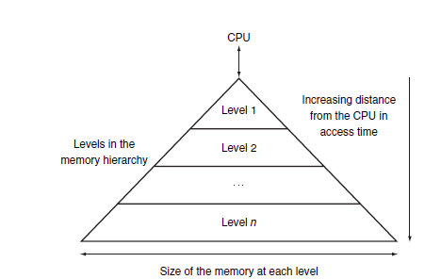
Continue
memory hierarchy uses smaller and faster memory technologies close to the processor.
Thus, accesses that hit in the highest level of the hierarchy can be processed quickly.
Accesses that miss go to lower levels of the hierarchy, which are larger but slower.

Slide 13
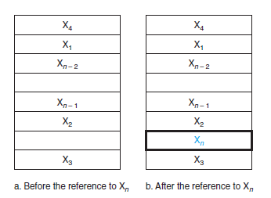
Cache
It refers to the level of memory hierarchy between the processor and main memory.
shows such a simple cache, before and after requesting a data item that is not initially in the cache. Before the request, the cache contains a collection of recent references X₁, X₂, . . . , X_{n - 1}, and the processor requests a word X_{n} that is not in the cache. This request results in a miss, and the word X_{n} is brought from memory into the cache.

Slide 14
Direct Mapped cache
In a direct-mapped cache each addressed location in main memory maps to a single location in cache memory. Since main memory is much larger than cache memory, there are many addresses in main memory that map to the same single location in cache memory.
Direct mapping is a procedure used to assign each memory block in the main memory to a particular line in the cache. If a line is already filled with a memory block and a new block needs to be loaded, then the old block is discarded from the cache.

Slide 15
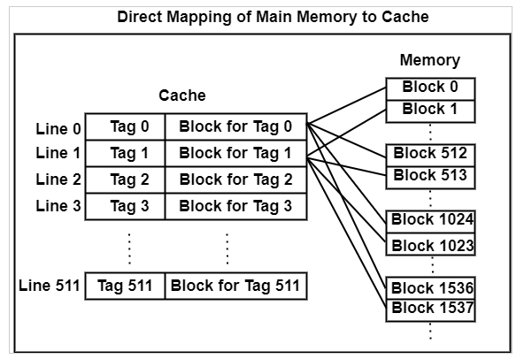
Direct Mapped cache

Slide 16
Direct Mapped cache
Tag: A unique identifier for a group of data. Because different regions of memory may be mapped into a block, the tag is used to differentiate between them.
Almost all direct-mapped caches use this mapping to find a block:
(Block address) modulo (Number of blocks in the cache)

Slide 17
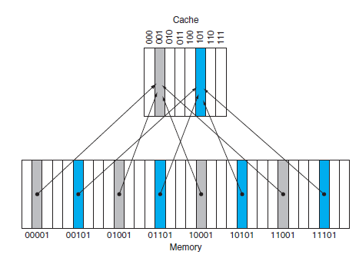
Continue
(Block address) modulo (Number of blocks in the cache)
If the number of entries in the cache is a power of 2, then modulo can be computed simply by using the low-order log₂ (cache size in blocks) bits of the address.
Thus, an 8-block cache uses the three lowest bits (8 = 2³) of the block address.

Slide 18
Tag
How do we know if a data item is in the cache?
We answer this question by adding a set of tags to the cache.
The tags Contain the address information required to identify whether a word in the cache corresponds to the requested word.
The tag needs only to contain the upper portion of the address, corresponding to the bits that are not used as an index into the cache.
In figure we need only the upper 2 of the 5 address bits in the tag, since the lower 3-bit index field of the address selects the block.

Slide 19
Valid Bit
We also need a way to recognize that a cache block does not have valid information.
For instance, when a processor starts up, the cache does not have good data, and the tag fields will be meaningless.
Even after executing many instructions, some of the cache entries may still be empty.

Slide 20
Valid Bit
Thus, we need to know that the tag should be ignored for such entries.
The valid bit is a bit indicating whether a cache slot contains useful information.

Slide 21
Valid Bit
When started, the cache is empty and odes not contain valid data.
We should account for this by adding a valid bit for each cache block.
When the system is initialised, all the valid bits are set to 0.
When data is loaded into a particular cache block, the corresponding valid bit is set to i.

Slide 22
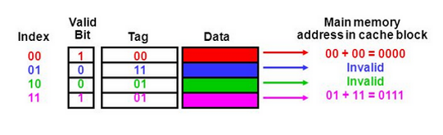
Valid Bit
So, the cache contains more than just copies of the data in memory; it also has bits to help us find data within the cache and verify its validity.

Slide 23
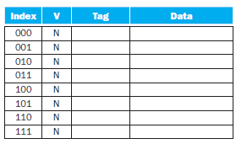
Accessing a cache-Example 1
Figure a. The initial state of the cache after power-on

Slide 24
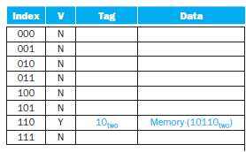
Accessing a cache-Example 1
Figure b. After handling a miss address (10110_{two})

Slide 25
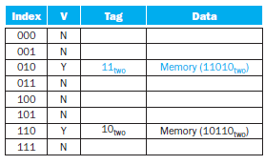
Accessing a cache-Example 1
Figure c. After handling a miss address (11010_{two})

Slide 26
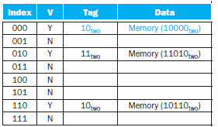
Accessing a cache-Example 1
Figure d. After handling a miss address (10110_{two})

Slide 27
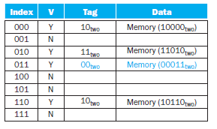
Accessing a cache-Example 1
Figure e. After handling a miss address (00011_{two})

Slide 28
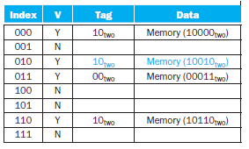
Accessing a cache-Example 1
Figure f. After handling a miss address (10010_{two})

Slide 29
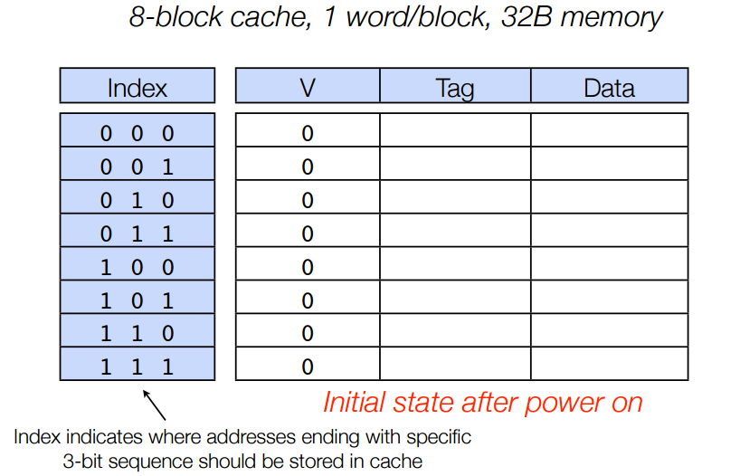
Accessing a cache-Example 2

Slide 30
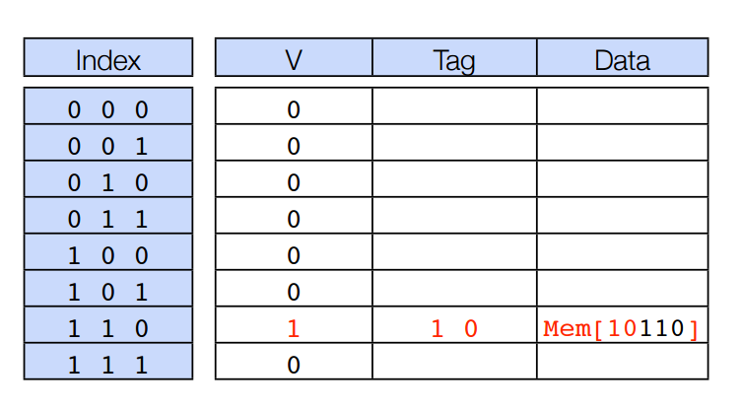
Accessing a cache-Example 2
Accessing a cache-After handling miss of address 10110

Slide 31
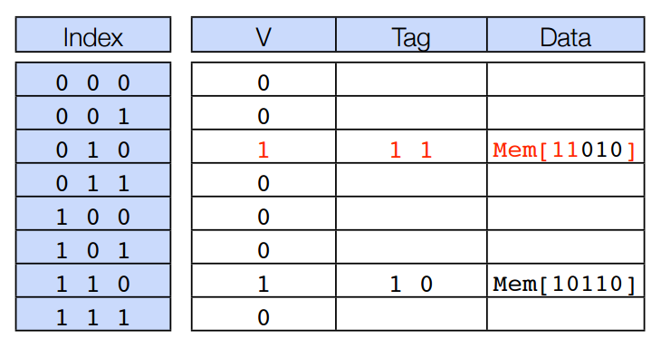
Accessing a cache-Example 2
Accessing a cache-After handling miss of address 11010

Slide 32
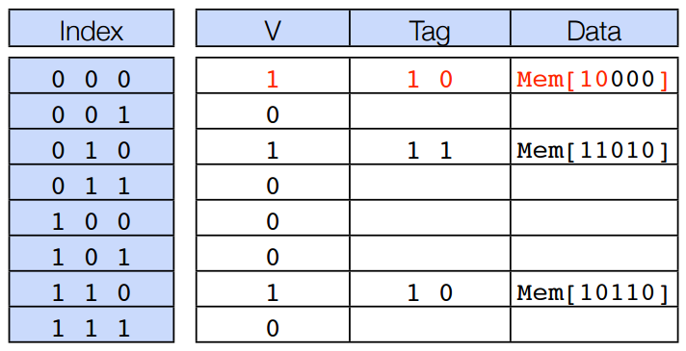
Accessing a cache-Example 2
Accessing a cache-After handling miss of address 10000

Slide 33
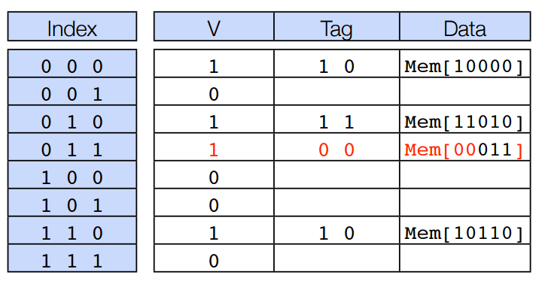
Accessing a cache-Example 2
Accessing a cache-After handling miss of address 00011

Slide 34

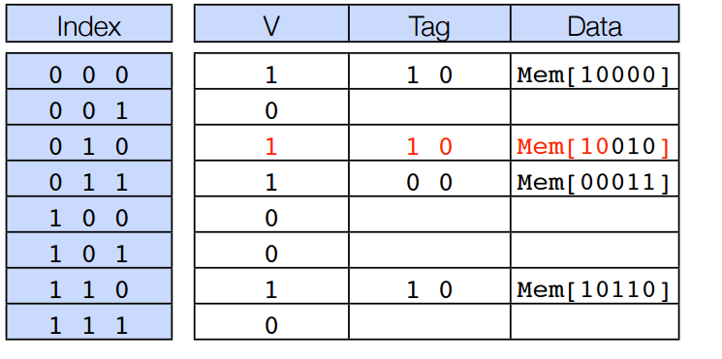
Accessing a cache-Example 2
Accessing a cache-After handling miss of address 00011

Slide 35
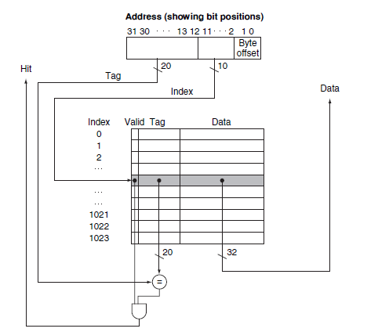
Referencing a Cache Block
A referenced address is divided into:
A tag field, which is used to compare with the value of the tag field of the cache
A cache index, which is used to select the block

Slide 36
Referencing a Cache Block
The index of a cache block, together with the tag contents of that block, uniquely specifies the memory address of the word contained in the cache block.
In the MIPS architecture, the least significant two bits of every address specify 1 byte within a line or block.

Slide 37
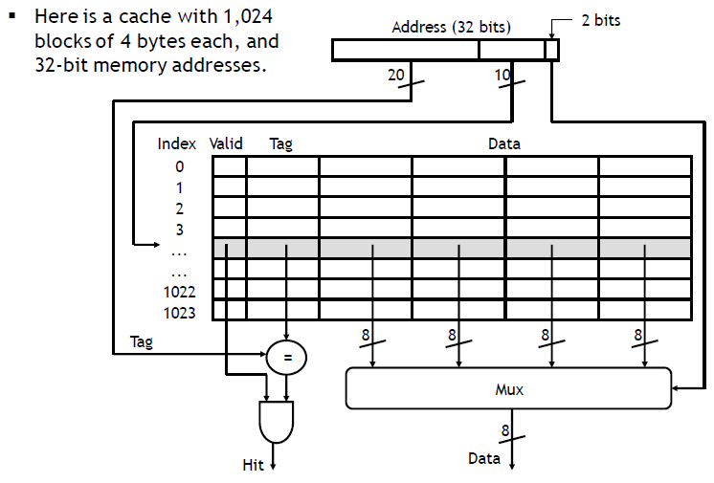
Referencing a Cache Block

Slide 38
Referencing a Cache Block
A multiplexer is now needed to select the word within the block. The multiplexer is controlled by the 2 block offset bits of the address.

Slide 39
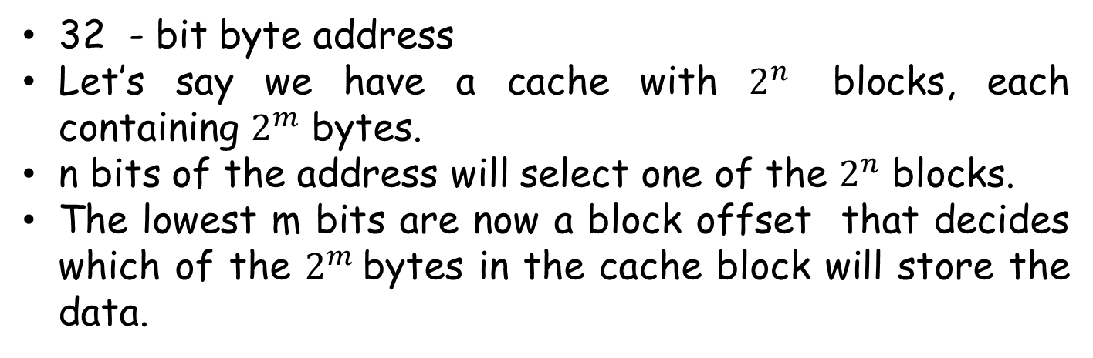
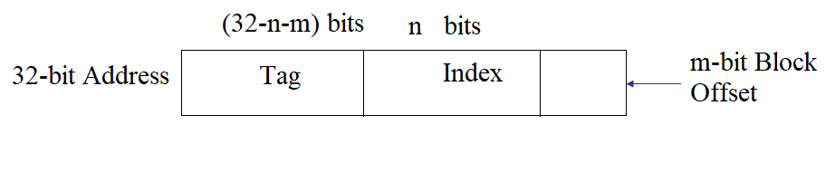
Number of tag bits in referenced address Block

Slide 40
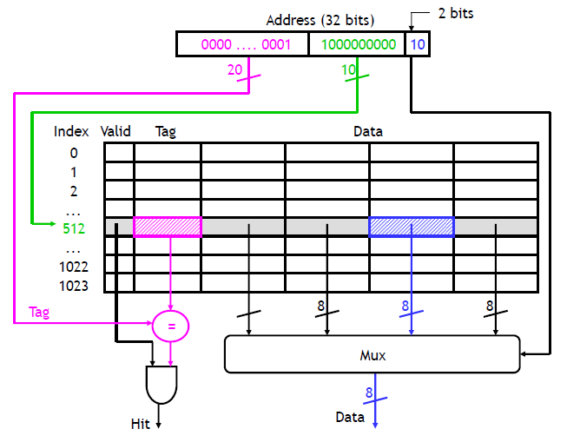
Example
Where would the byte from memory address 6146 be stored in this direct-mapped 2¹⁰-block cache with 2²-byte blocks?
6146 in binary is 00...01 1000 0000 0010.

Slide 41
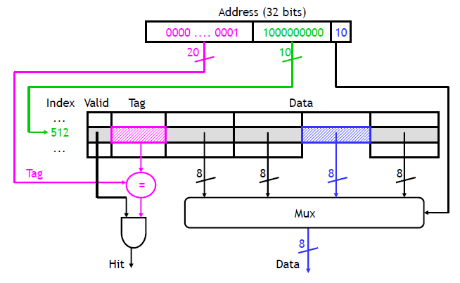
What goes in the rest of that cache block?
The other three bytes of that cache block come from the same memory block, whose addresses must all have the same index (1000000000) and the same tag (00...01).

Slide 42
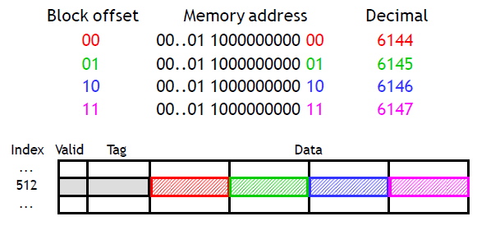
The rest of that Cache
Again, byte i of a memory block is stored into byte i of the corresponding cache block. In our example, memory block 1536 consists of byte addresses 6144 to 6147. So bytes 0-3 of the cache block would contain data from address 6144, 6145, 6146 and 6147 respectively. You can also look at the lowest 2 bits of the memory address to find the block offsets.

Slide 43
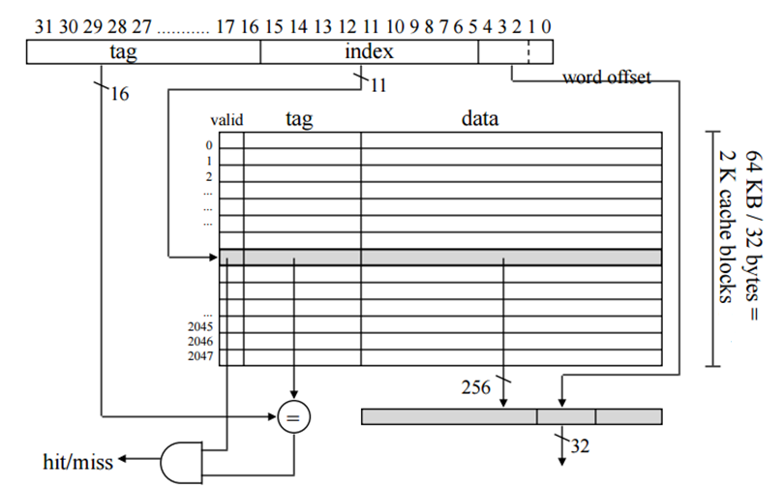
64 Kbyte cache, direct-mapped, 32-byte cache block size

Slide 44
Byte and word
1 Word is always 32-bit (4 byte).

Slide 45


Example
For a direct-mapped cache design with a 32-bit address and byte-addressable memory, the following bits of the address are used to access the cache:
What is the cache line size (in words)? How many entries (cache lines) does the cache have? Cache lines are also called blocks.
Solution

Slide 46
Bits in a Cache
The total number of bits in a direct-mapped cache is
2^{n} × (block size (byte) + tag size + valid field size).

Slide 47

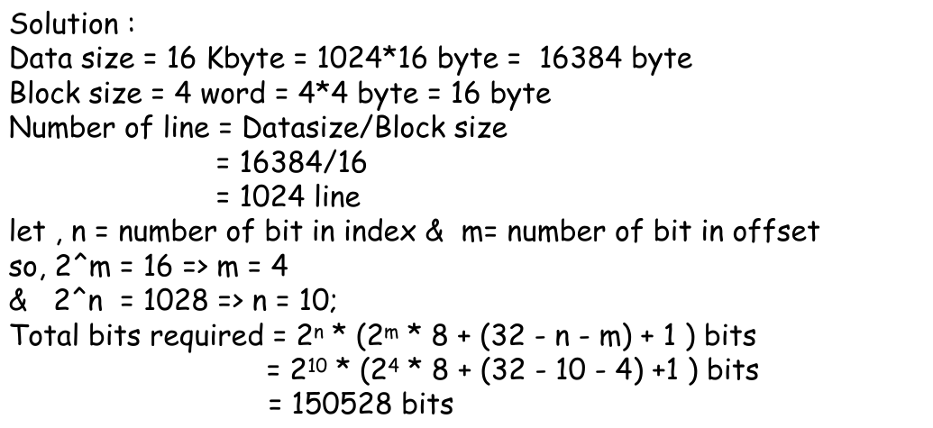
How many total bits are required for a direct-mapped cache with 16 Kbyte of data and 4-word blocks, assuming a 32-bit address?

Slide 48
(Do it Yourself)
How many total bits are required for a direct-mapped cache with 64KByte of data and one-word blocks, assuming a 32-bit address?

